Slide 1

Table of Contents
Printing to the Console
Printing Strings and Numbers
Reading from the Console
Reading Characters
Reading Strings
Parsing Strings to Numeral Types
Reading Numeral Types
Various Examples

Slide 2
Console.Read()
Gets a single character from the console (after [Enter] is pressed)
Returns a result of type int
Returns -1 if there aren’t more symbols
To get the actually read character we need to cast it to char
int i = Console.Read();
char ch = (char) i; // Cast the int to char
// Gets the code of the entered symbol
Console.WriteLine("The code of '{0}' is {1}.", ch, i);

Slide 3
Console.ReadKey()
Waits until a combination of keys is pressed
Reads a single character from console or a combination of keys
Returns a result of type ConsoleKeyInfo
KeyChar – holds the entered character
Modifiers – holds the state of [Ctrl], [Alt], …
ConsoleKeyInfo key = Console.ReadKey();
Console.WriteLine();
Console.WriteLine("Character entered: " + key.KeyChar);
Console.WriteLine("Special keys: " + key.Modifiers);

Slide 4
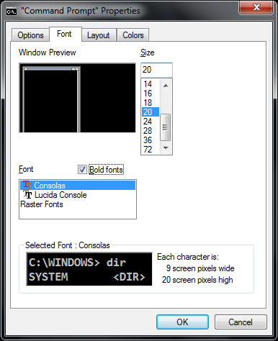
How to Print Special Characters on the Console?
Printing special characters on the console needs two steps:
Change the console properties to enable Unicode-friendly font
Enable Unicode for the Console by adjusting its output encoding
Prefer UTF8 (Unicode)
using System.Text;
…
Console.OutputEncoding = Encoding.UTF8;
Console.WriteLine("Това е кирилица: ☺");

Slide 5

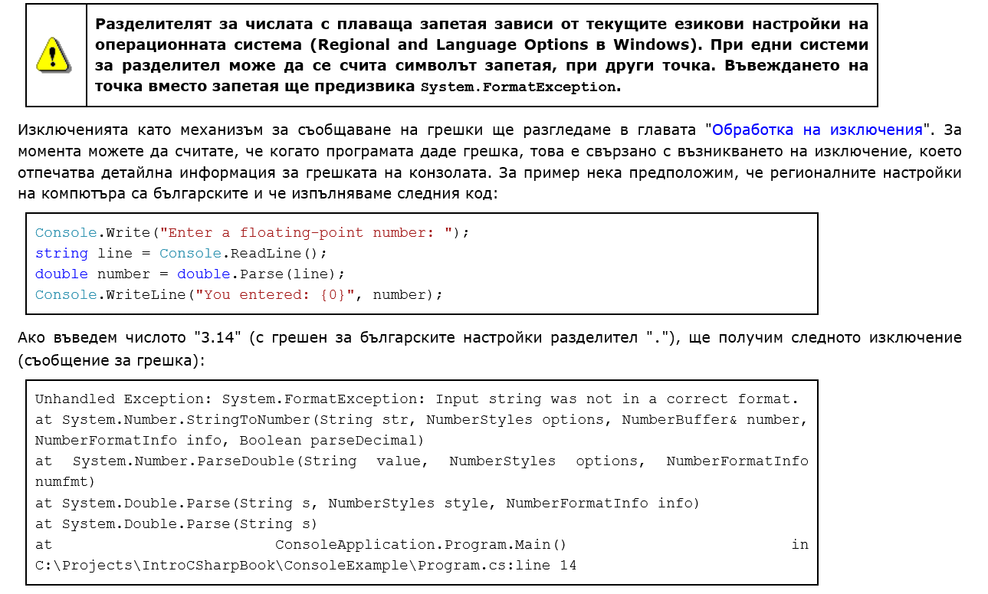

Slide 6
Formatting Strings
{index[,alignment][:formatString]}
index
The zero-based index of the argument whose string representation is to be included at this position in the string
alignment
A signed integer that indicates the total length of the field into which the argument is inserted
a positive integer – right-aligned
a negative integer – left-aligned

Slide 7
Reading Numeral Types
Numeral types can not be read directly from the console
To read a numeral type do the following:
Read a string value
Convert (parse) it to the required numeral type
int.Parse(string)
Parses (converts) a string to int
string str = Console.ReadLine()
int number = int.Parse(str);
Console.WriteLine("You entered: {0}", number);

Slide 8
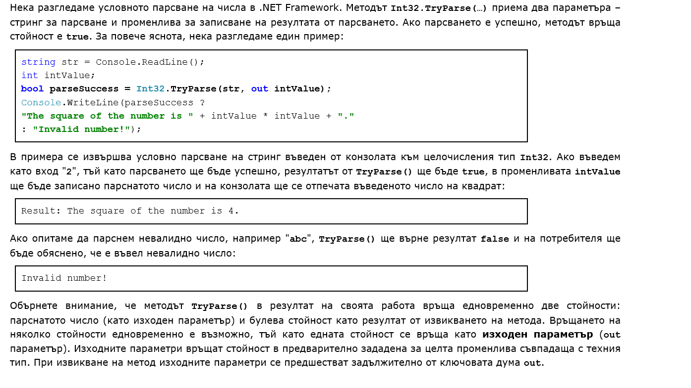

Slide 9

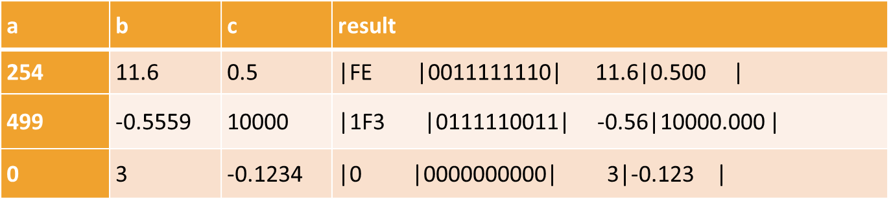
Write a program that reads 3 numbers:
integer a => should be printed in hexadecimal, left aligned,
then the number a should be printed in binary form;
floating-point b => should be printed with 2 digits after the decimal point, right aligned;
floating-point c => should be printed with 3 digits after the decimal point, left aligned;
Prints them in 4 virtual columns on the console.
Each column should have a width of 10 characters.

Slide 10

Declare 3 variables: an integer 'a' and two double variables 'b' and 'c'.
Parse the input from the console by calling the double.Parse() method and pass the Console input as parameter (Console.ReadLine()).
Print the values of the variables with one single Console.WriteLine() method and use formatted strings:
To format a number to hexadecimal use {0:X};
To format a number to binary use Convert.ToString(number, 2). Then to add zeros to the left side of the number use .PadLeft(10, '0');
To format a number rounded to 2/3 decimal points use {0:F2/3} or {0.00/0};
To align numbers 10 digits to the right or to the left use {0, ±10};

Slide 11
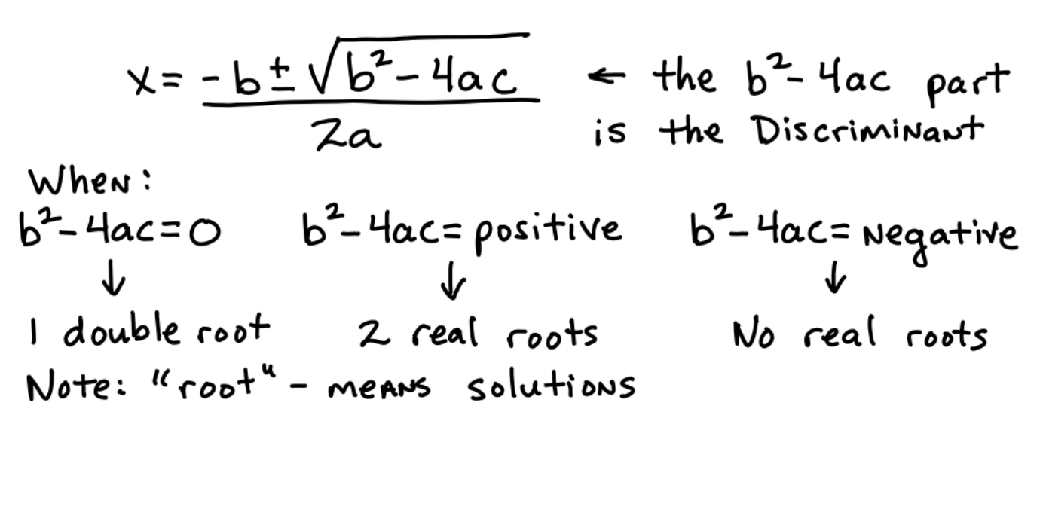


Slide 12



SoftUni-Plovdiv
https://softuni.bg/forum

